Slide 1
Mobile First Framework Design
Introduce Haxejs – The next generation mobile first framework

Slide 2
What Mobile means in people’s mind?
Device -- Small, light weight
Device -- Input method change – from mouse + keyword to finger tap/gesture + virtual keyboard + voice + image/video + GPS + other sensors input
Device -- Be usable anywhere at any time
App -- Fast, responsive
App – Focused, Concise, Objective
App – Do not let me think

Slide 3
Business value of mobile technologies
As technology advances, usage patterns change, and new business tools, such as smartphones and tablets, emerge. Mobile applications are no longer side effects of the social media empire, but have become an essential tool for business productivity.
Every day, countless confidential transactions with financial institutions, online merchants, airlines, and various other retailers are performed on mobile devices. These transactional trends have been analyzed, and used to formulate innovative, mobile-based advertising strategies, such as location-based advertising campaigns. These strategies have paid off:75% of mobile shoppers take action after receiving location-based messages.
Increasingly, people use mobile devices as their primary means of interaction and communication with employers, customers, family, and friends. According to recent studies, 91% of mobile users keep their device in reach 100% of the time. Therefore, providing a highly available, innovative, employee-focused, and customer-focused mobile presence has become crucial to enterprise success and growth.

Slide 4
Enterprises need mobile strategy
To attract new customers, transform your value chain, and increase productivity
To engage users by delivering applications (apps) that are created with simplified multi-channel development solutions
To turn interactions into an opportunity for return on engagement and investment
To provide a consistent brand experience
To deliver innovation by using cloud technologies to meet increased IT demands, to lower costs, and to gain insights, visibility, and control

Slide 5
一个真实的售前项目的客户需求
版本 | 说明 | 备注
PC网站 | 主体 | ——
手机版网站 | 基于PC网站数据 | 二维码扫描进入
IOS | 苹果移动客户端, 基于PC网站数据 | 链接/二维码下载
Android | 安卓手机客户端, 基于PC网站数据 | 链接/二维码下载
()

Slide 6

一个都不能少

Slide 7
Battles of OS vendors and 3rd Developers
OS vendors want Differentiations for wars between themselves
3rd Developers want Cross platform to save cost and broader channels

Slide 8
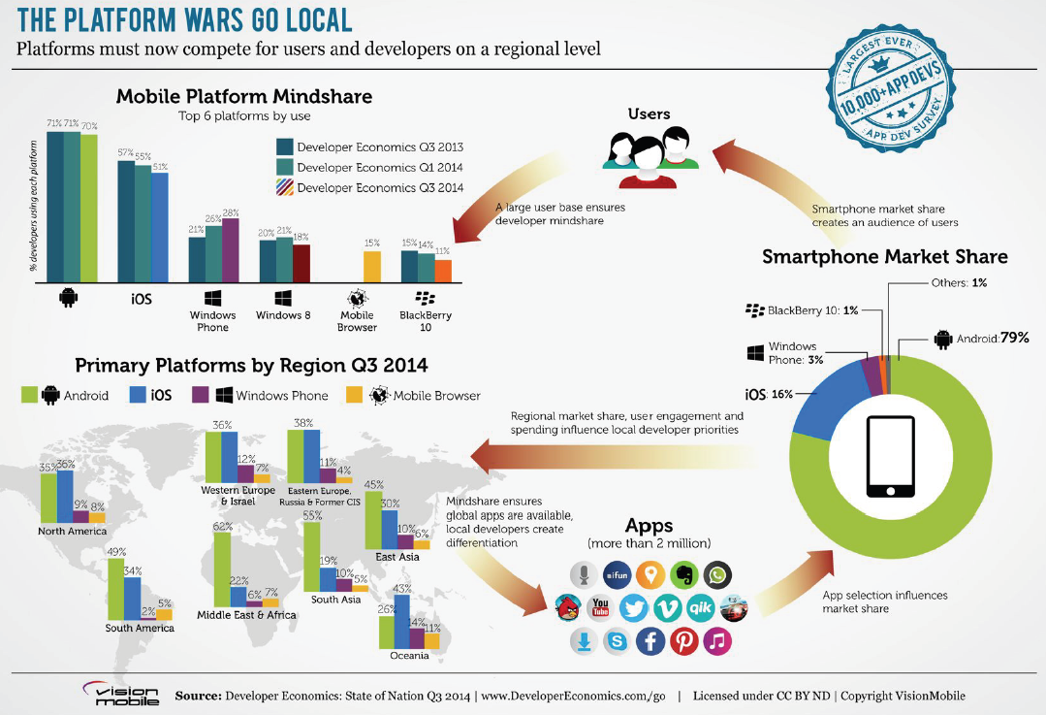

Slide 9
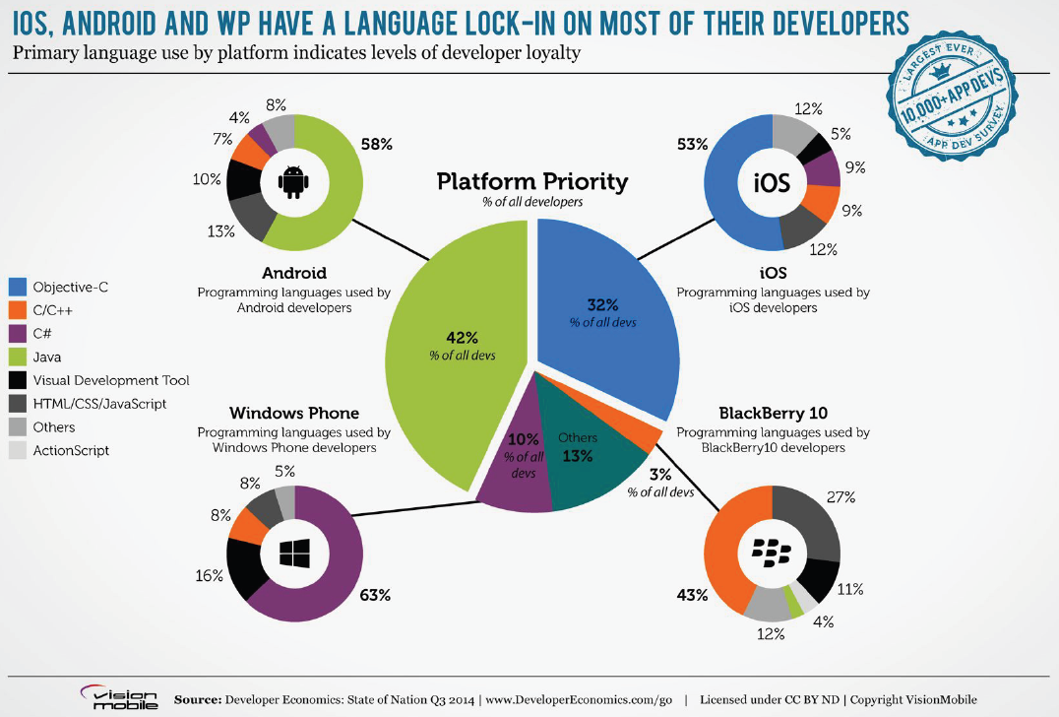

Slide 10
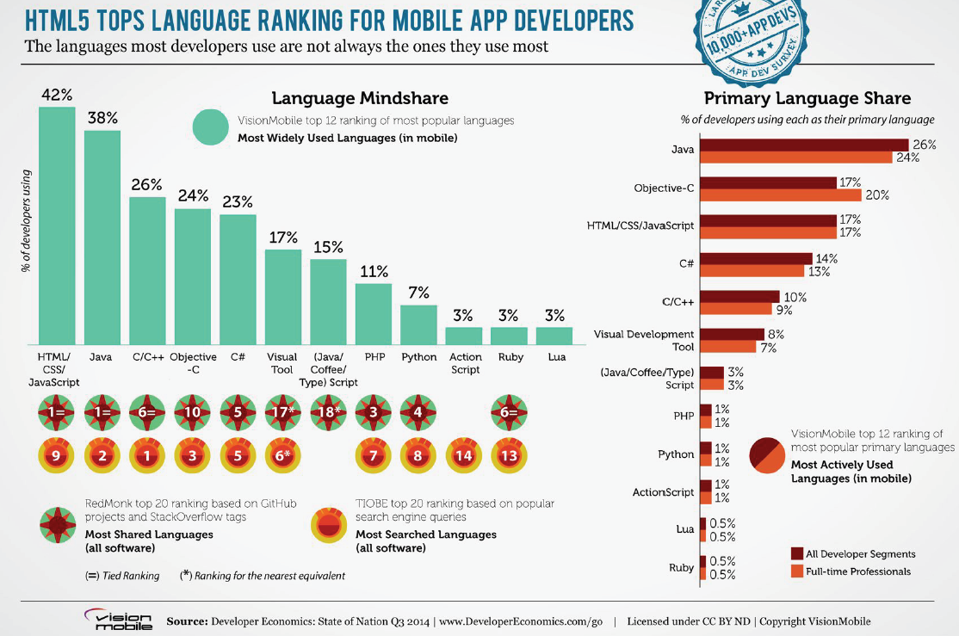

Slide 11
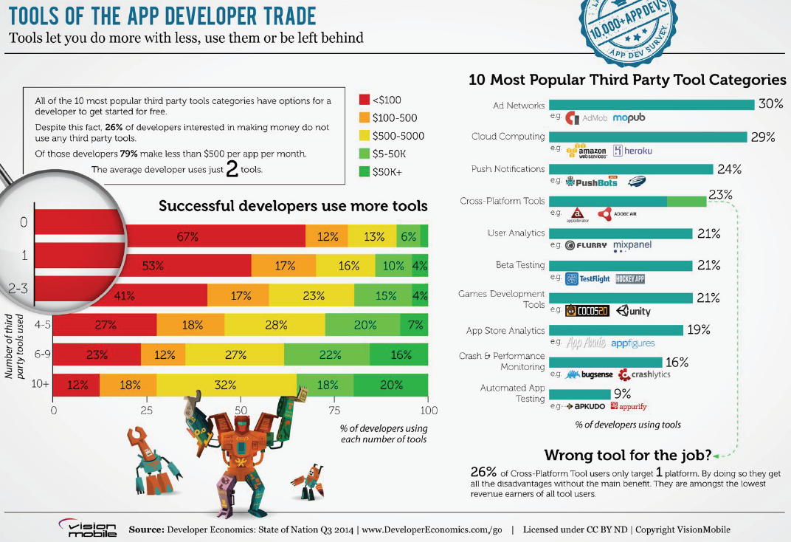

Slide 12

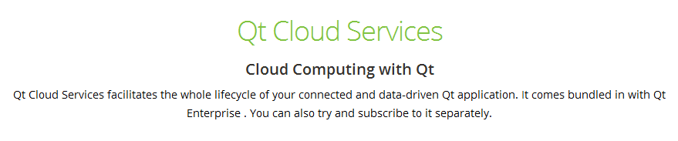
QT’s Mobile First Strategy – Dev Tool + Cloud Service

Slide 13
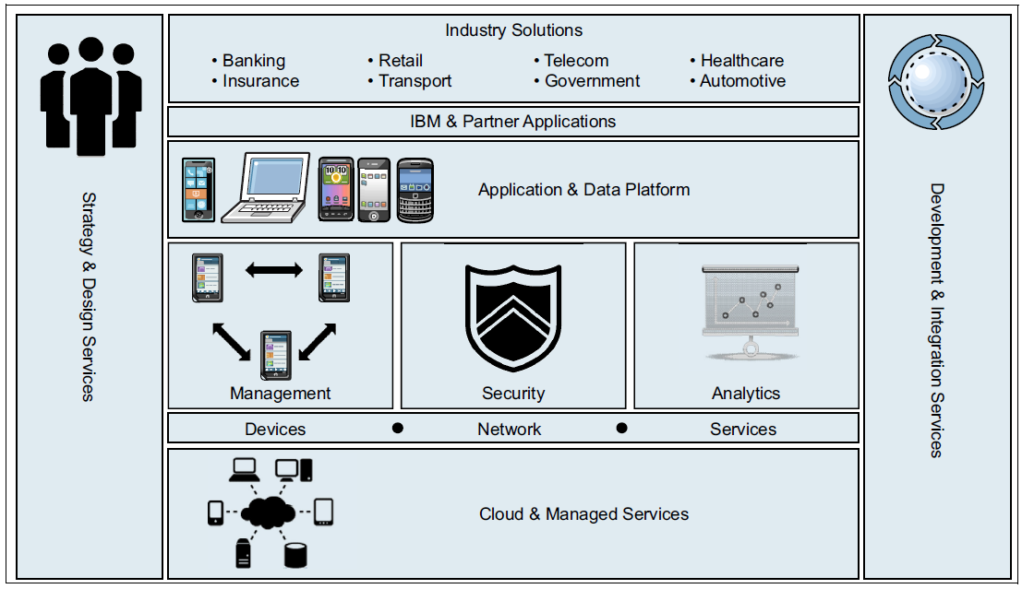
IBM MobileFirst Solution

Slide 14
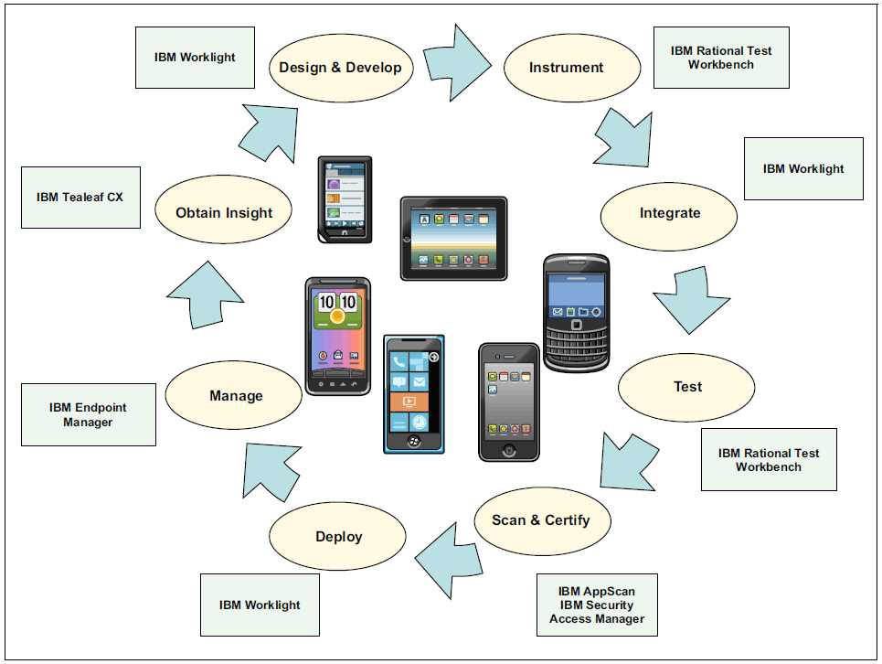
IBM MobileFirst Platform

Slide 15
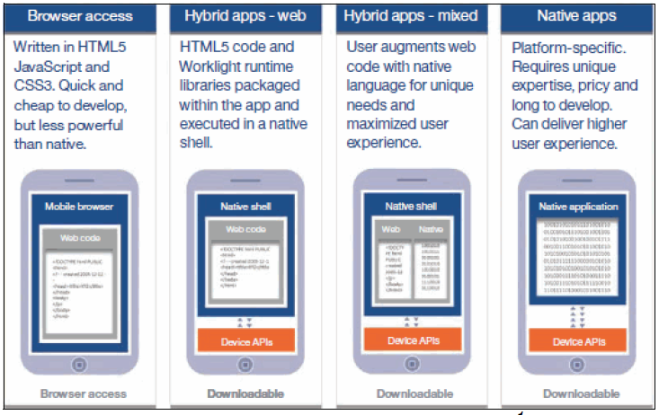
Mobile application types

Slide 16
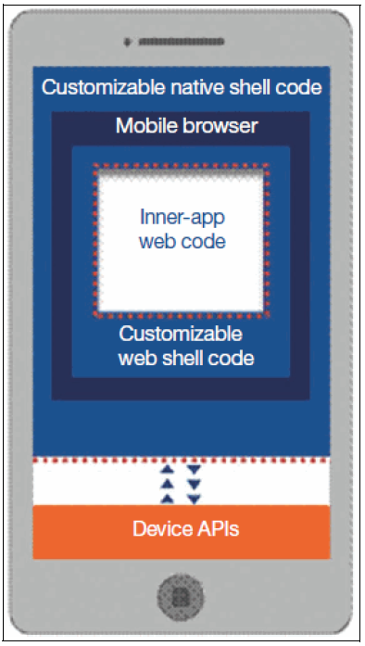
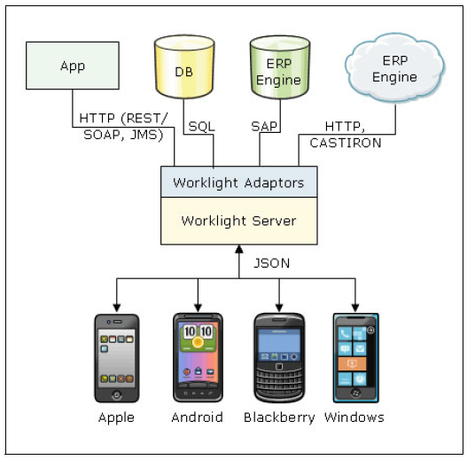
IBM Worklight

Slide 17
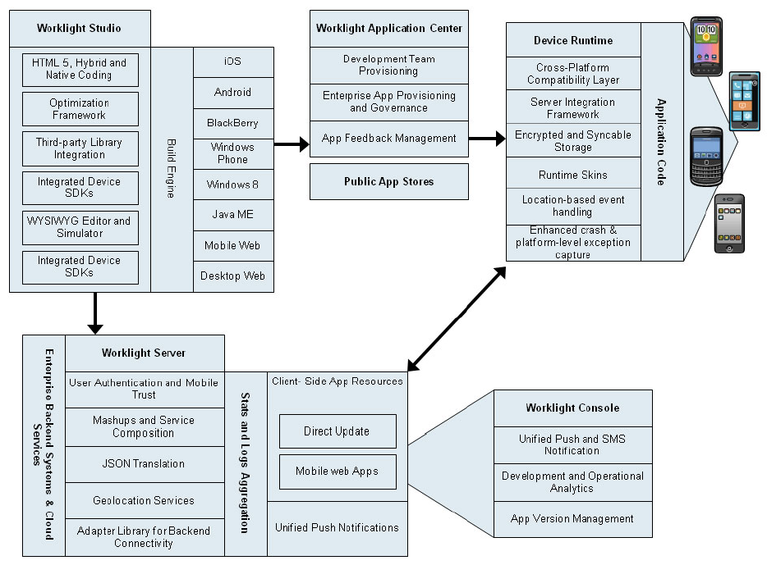

Slide 18
Google’s Mobile First
"We understand that the new rule is mobile first," Schmidt said. "Mobile first in everything. Mobile first in terms of applications. Most first in terms of the way people use things. And it means … that we have a role now to inform, to educate through all these devices.“
Google programmers now want to do work on mobile first, before the desktop, Schmidt said. "That is, in fact, a change," he said. "Every product announcement we've done recently – of course we'll have a desktop version – but we'll also have one on a high-performance mobile phone."
Eric Schmidt said in 2010

Slide 19
CS vs BS，HTML5 is the future
BS becomes more responsive and more powerful by html5 + better javascript engines: websocket, webgl, canvas which are all adapted from CS precedent.
CS gets more flexibilities and more accessible by learning from BS: UI expressed by xml, embed web view, app store distribution channels

Slide 20
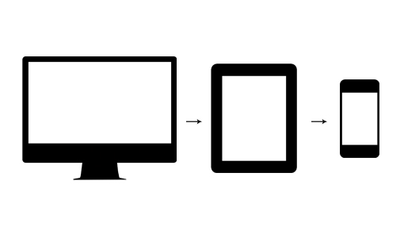
Graceful Degradation
Historically, most web designers and their clients have approached the desktop side of any project first, while leaving the mobile part as a secondary goal that gets accomplished later.
They think a full, standard website would scale back and gradually remove content and features as the viewport became smaller and the system simpler (no Flash support, etc.).

Slide 21
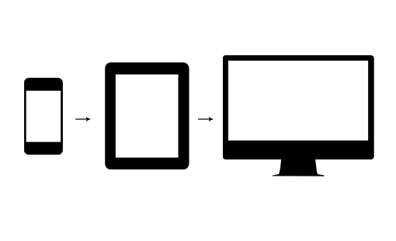
Progressive Enhancement
Put your best foot forward on the mobile platform, providing the users with minimal screen real estate, processing power and third party plugins an amazing experience that both looks great and functions perfectly.
As the need arises, the site can gradually be “enhanced” and even completely rethought for larger platforms with fewer constraints.

Slide 22
Start from Mobile Web
Hybrid App
Mobile Web
2
Only choose one from Hybrid and Native
1
Native App
3
Desktop Web
4

Slide 23

Rethink How to build Desktop web
Should our server generate html pages dynamically like before?
It is just only one of the channels

Slide 24
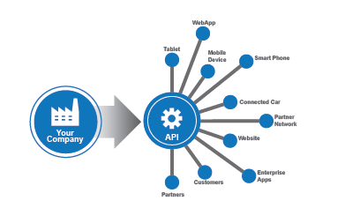
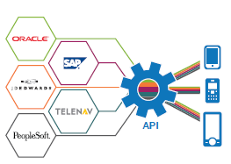
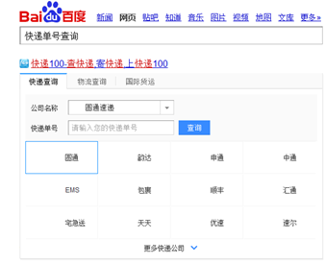
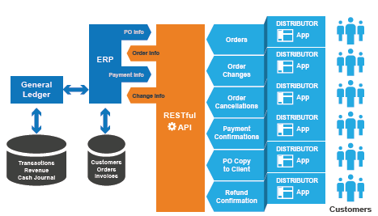
Delivering on your Mobile Strategy with APIs

Slide 25
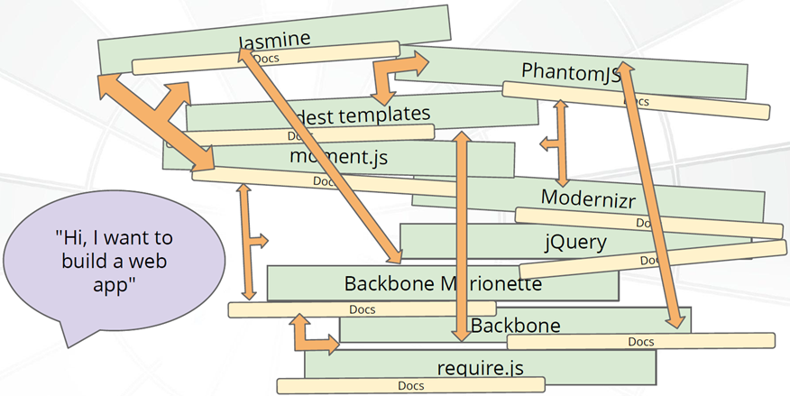
Haxejs: The Angularjs Ecosystem Hub

Slide 26
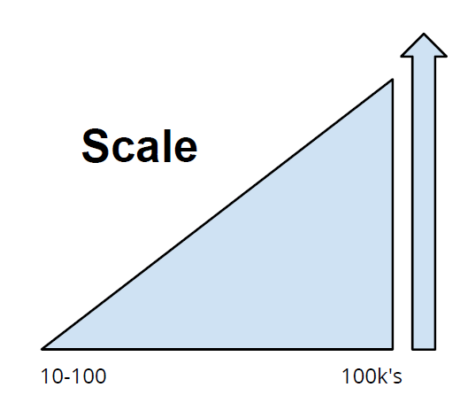
Born for large scale mobile/web app
“Haxejs helps developers from all platforms
build complex, high performance client apps
for the modern web.”
What is wrong with JavaScript?
● Lack of structure
● Very difficult to find dependencies
● All numbers are floats
● Monkey patching
● Keep on truckin' mentality
● Libraries are files you concatenate
... which makes it ...
● Difficult to optimize performance
● Difficult to maintain large code bases
● Difficult to assert correctness

Slide 27
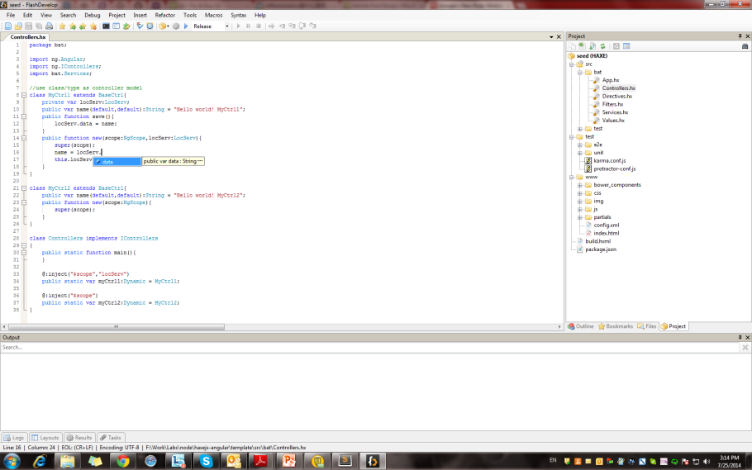

Write javascript code easier, small learn curve
Use modern, high level, strictly typed programming language Haxe(very similar to Java) to generate elegant javascript, it provides compiler error check and code completions with many IDE tools.

Slide 28
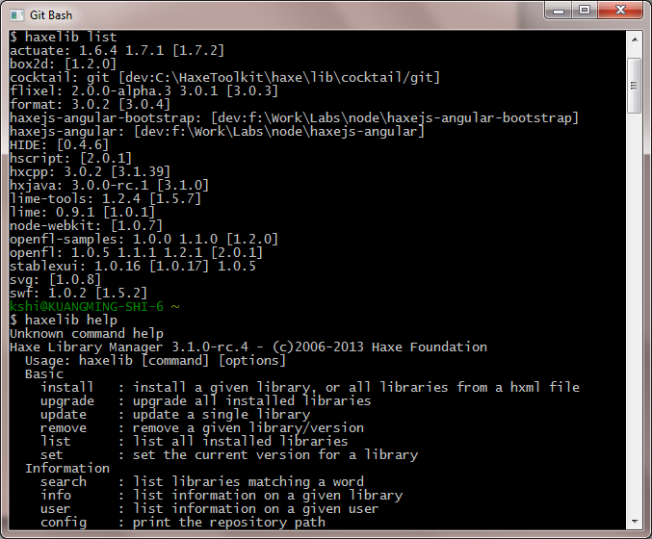
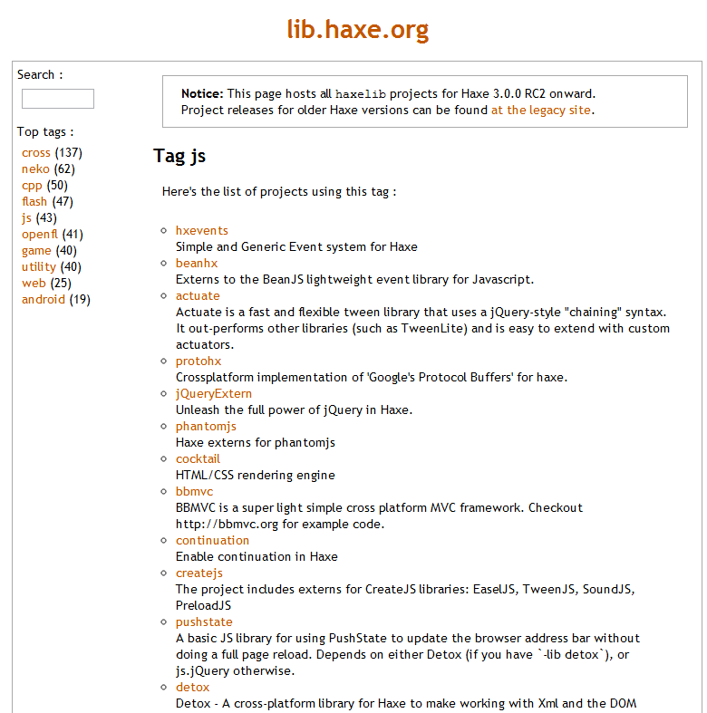
Cut-edge library(package) manager
Hundreds of libraries (packages) are easy to put under your fingers, give you lots of choices.

Slide 29
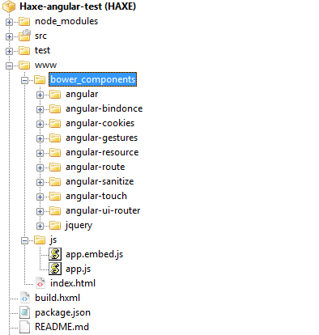
Manage javascript libraries easier, embedded or not embedded
It can embed javascript libraries you used automatically, or copy them to a pointed place.

Slide 30
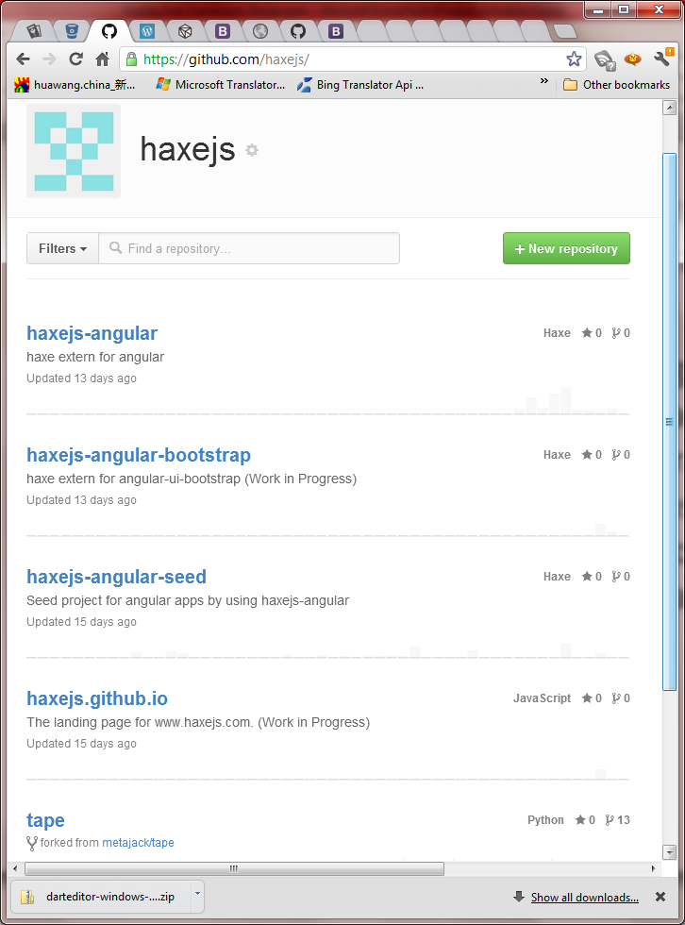
Very powerful with core design of angularjs, and adapted jquery and bootstrap
Angularjs is elegant and well designed, and it is the core of haxejs framework, many good javascript libraries based on angularjs are integrated/added seamlessly.

Slide 31
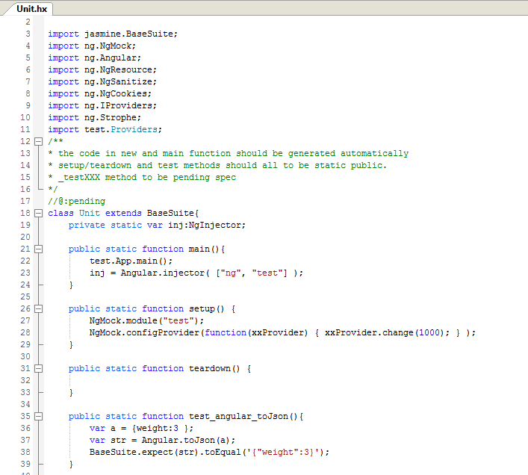
Write Unit and E2E tests easier
Jasmine, karma, protractor are included

Slide 32
Demo

Slide 33
Roadmap
It is open sourced
Improve code base
A website, a discuss board to communicate
Template projects
More Angularjs directives/services
Integrate D3/Timeline/Chart and etc
Improve Eclipse Haxe Plugin (IDE)
Better experience to write HTML with Angularjs directives
Security(authentication, authorization and etc) for different backends
Externalizing traditional services and applications(like SAP, OTM, PeopleSoft and etc) as APIs

Slide 34
Dart + Polymer
They are the future, Haxejs is now.
Dart IE9+ , Polymer IE10+

Slide 35
“Good design is good business.”
THOMAS WATSON, Jr.

